Slide 1

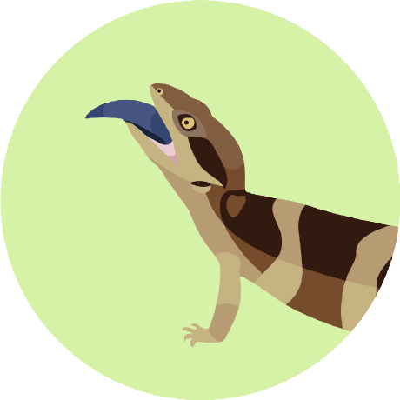

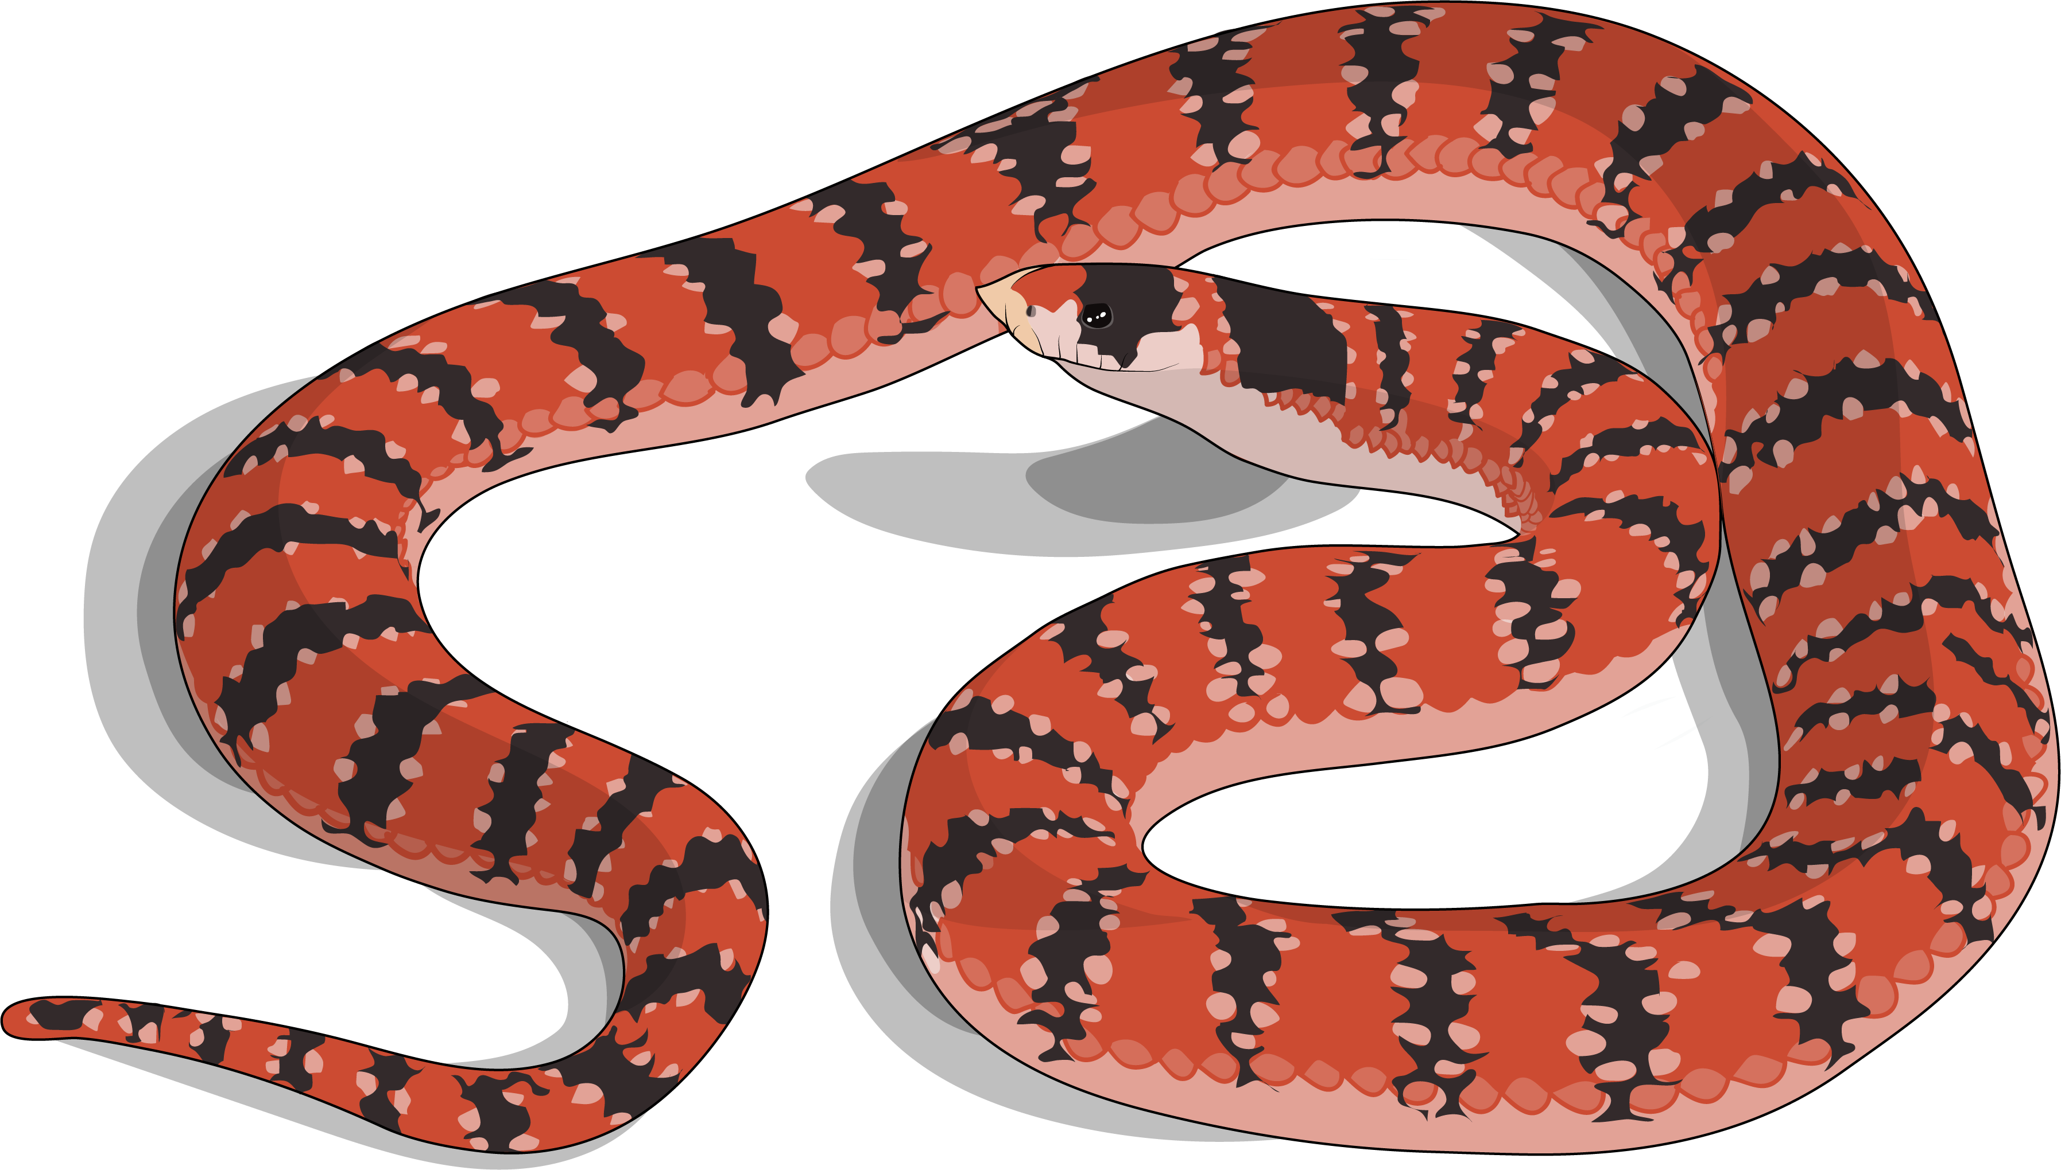
Ian Brennan
myriad stories of
evolution
Research Presentation

Slide 2


Slide 4

Genomics

Slide 5
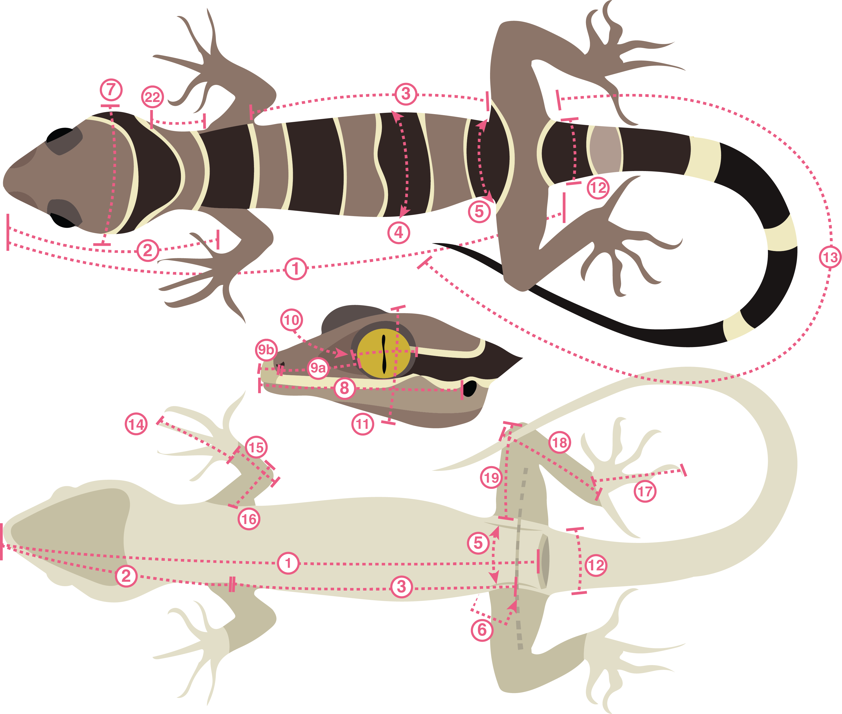
Genomics
Phenomics

Slide 6



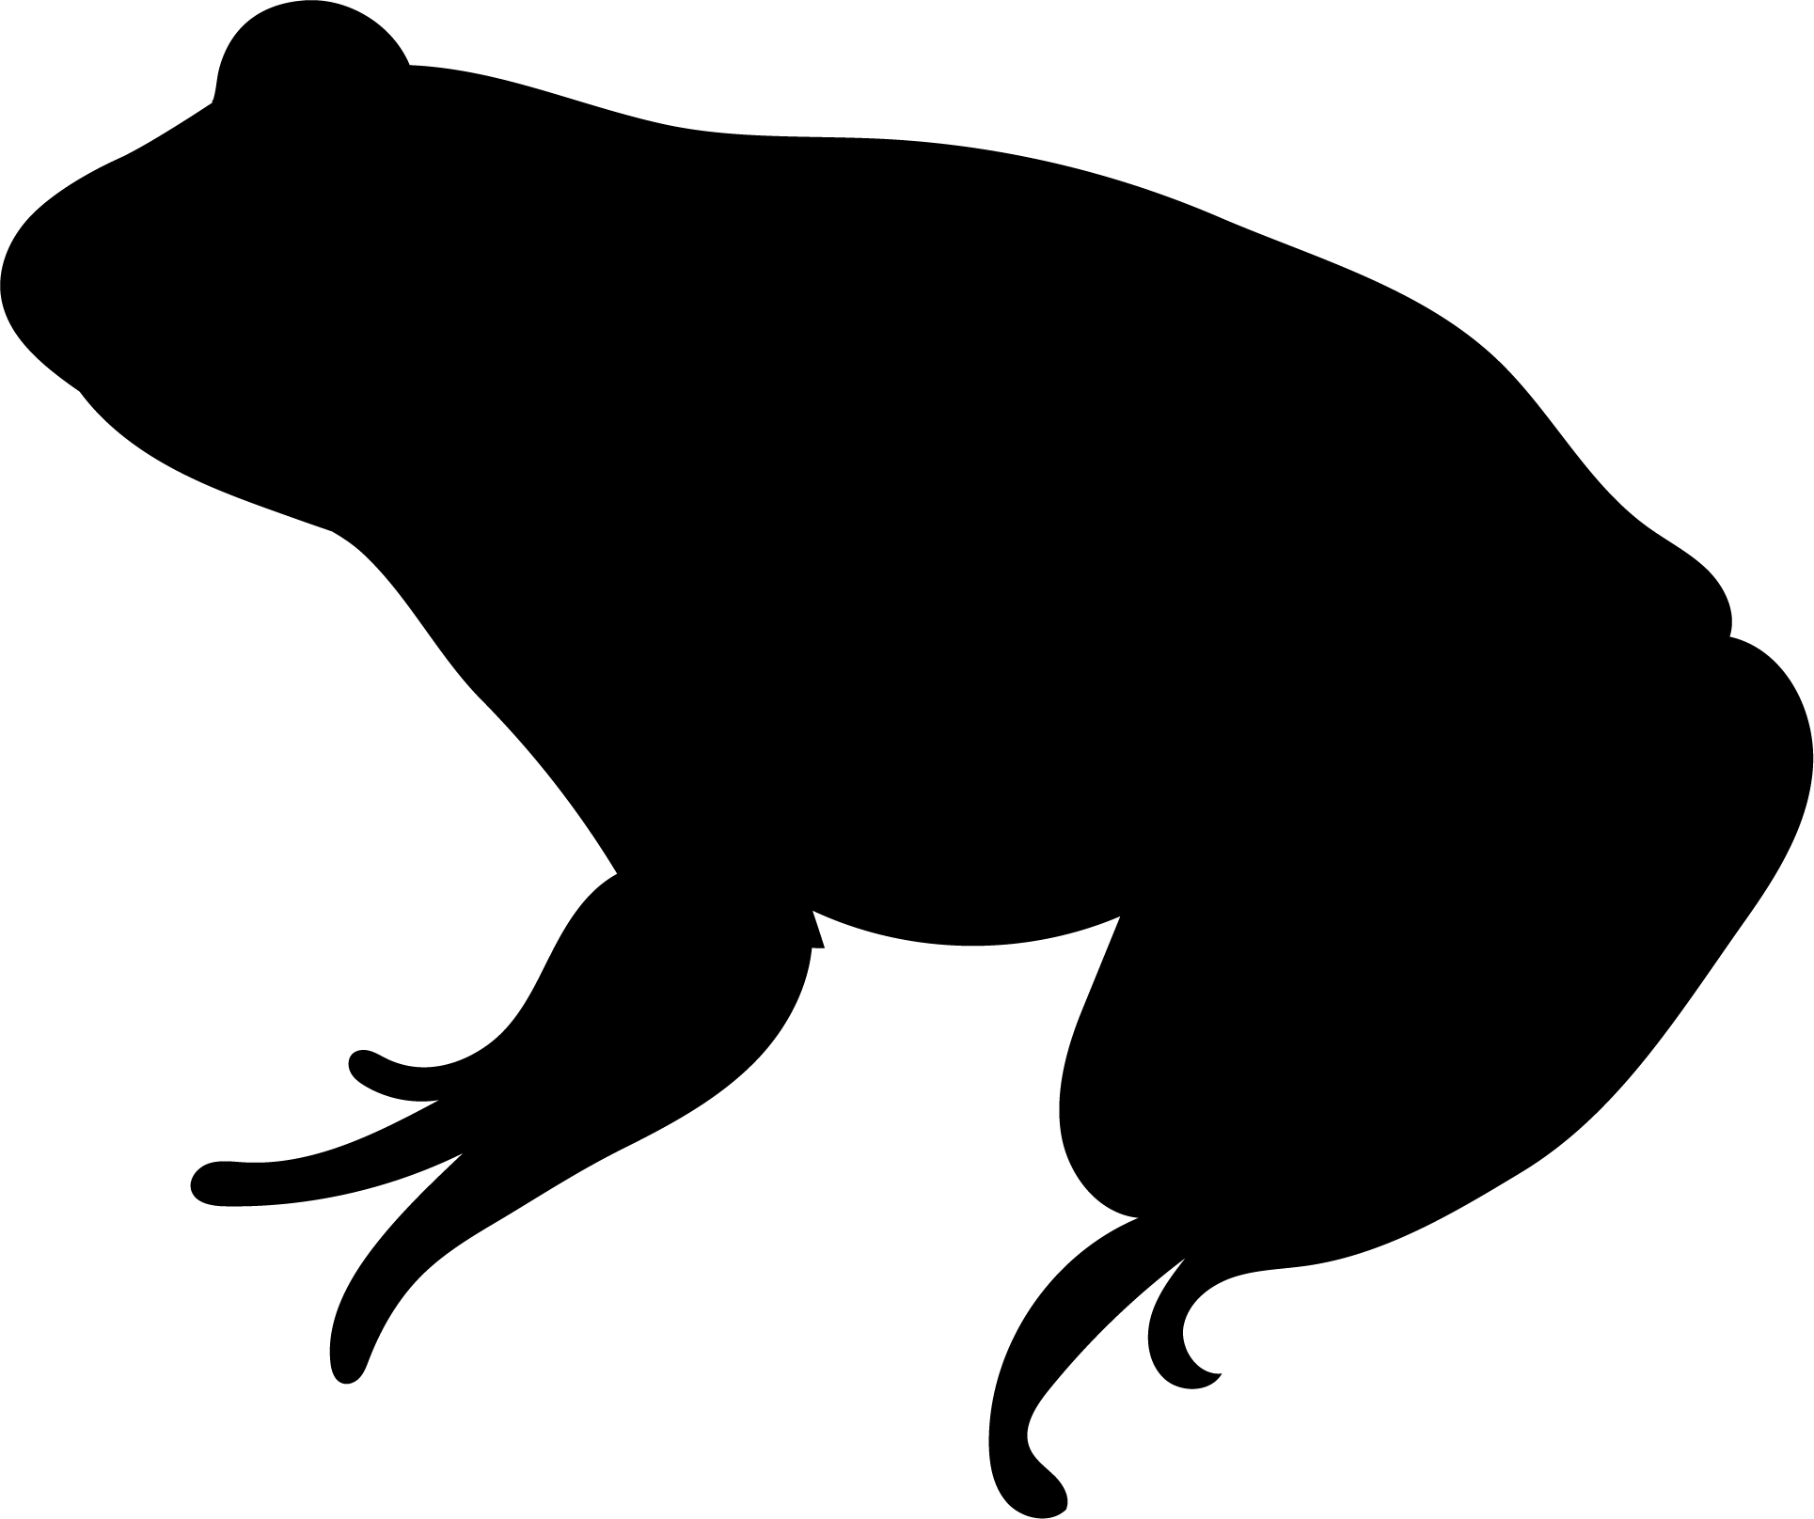
the evolution of biodiversity
Genomics
Phenomics

Slide 8
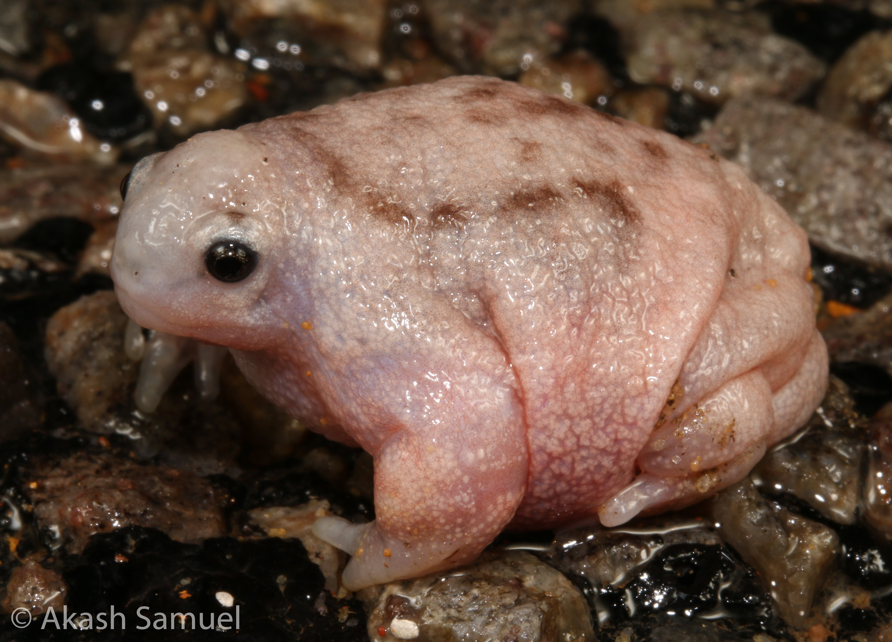
Turtle Frog
Myobatrachus gouldii

Slide 9
WORLD’S WORST FROG?
Turtle Frog
Myobatrachus gouldii
Notes:
CAN’T JUMP, NO TADPOLES, BARELY CALLS, IS IT WORLD’S WORST FROG?

Slide 10






11,000+
species of lizards & snakes
(Squamate reptiles)

Slide 11
~10% are Australian!

Slide 12

331
750
1000
250

Slide 13


BUILDING A TREE OF
A U S T R A L I A’ S
REPTILES & AMPHIBIANS
Notes:
THE FIRST

Slide 14
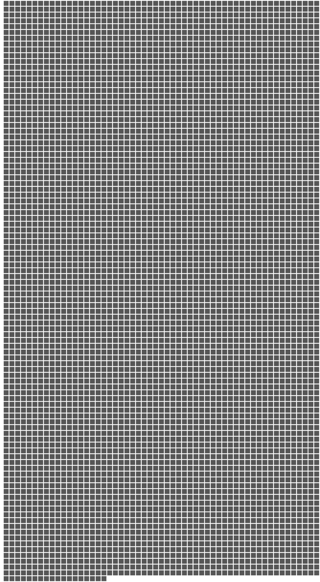
❶
Phylogenomics
5.5k NUCLEAR LOCI FROM 2500+ SAMPLES
=
1 NUCLEAR LOCUS

Slide 15
❶
Phylogenomics
5.5k NUCLEAR LOCI FROM 2500+ SAMPLES
ALL ~1K SPECIES
+ INTRASPECIFIC
+ CRYPTIC DIVERSITY
=
1 NUCLEAR LOCUS

Slide 16
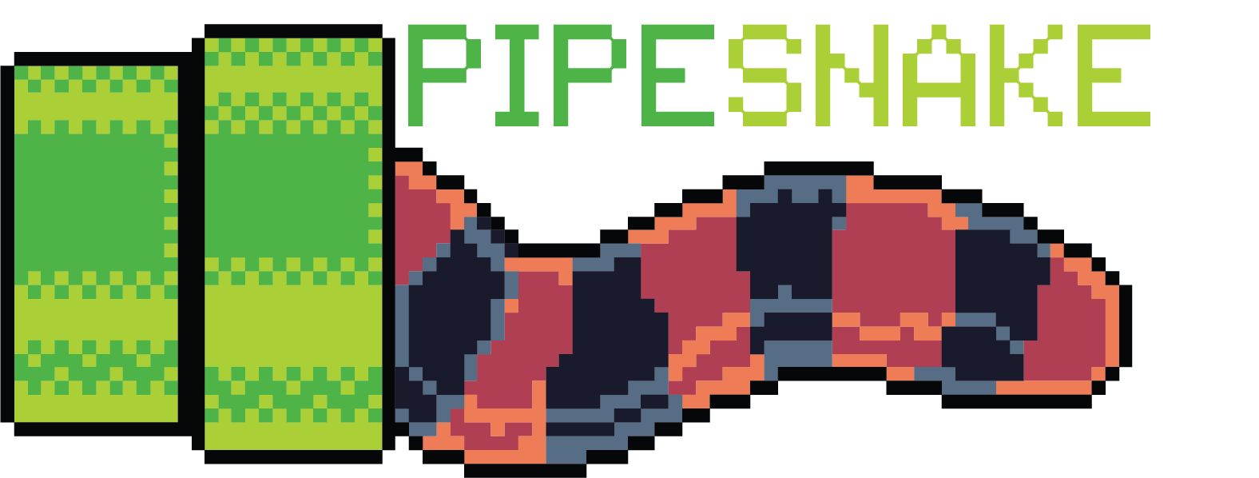
generalized software for the assembly and analysis
of phylogenomic datasets from genomic loci

Slide 17


Slide 18
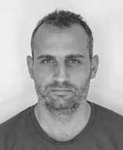

Notes:
Emphasize collaborations with Australian BioCommons, software engineers, and international evolutionary biologists.

Slide 19
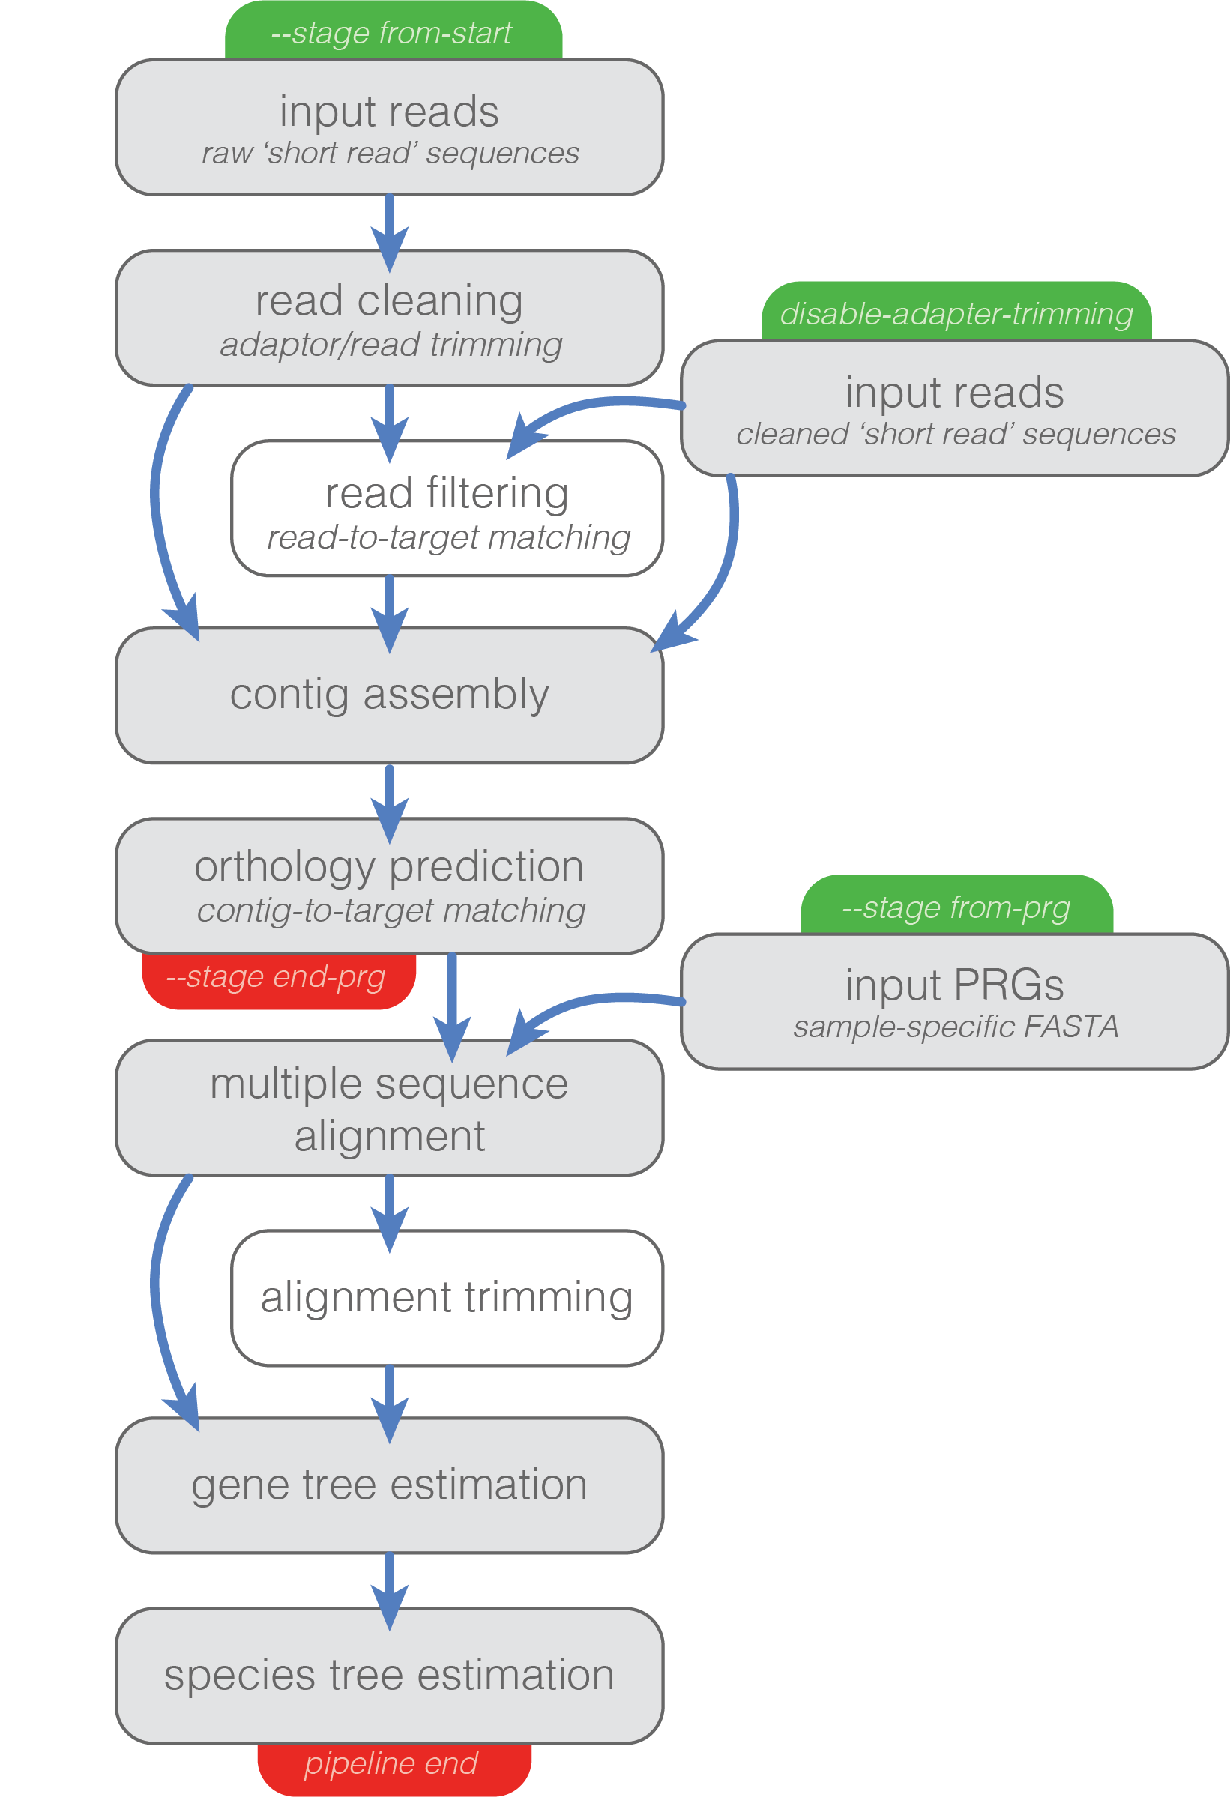
ending points
starting points
Notes:
A next generation sequencing pipeline that takes raw sequence data and processes it all the way to a species tree.
It’s designed to be flexible, so there are multiple start and stop points that make it modular.

Slide 20
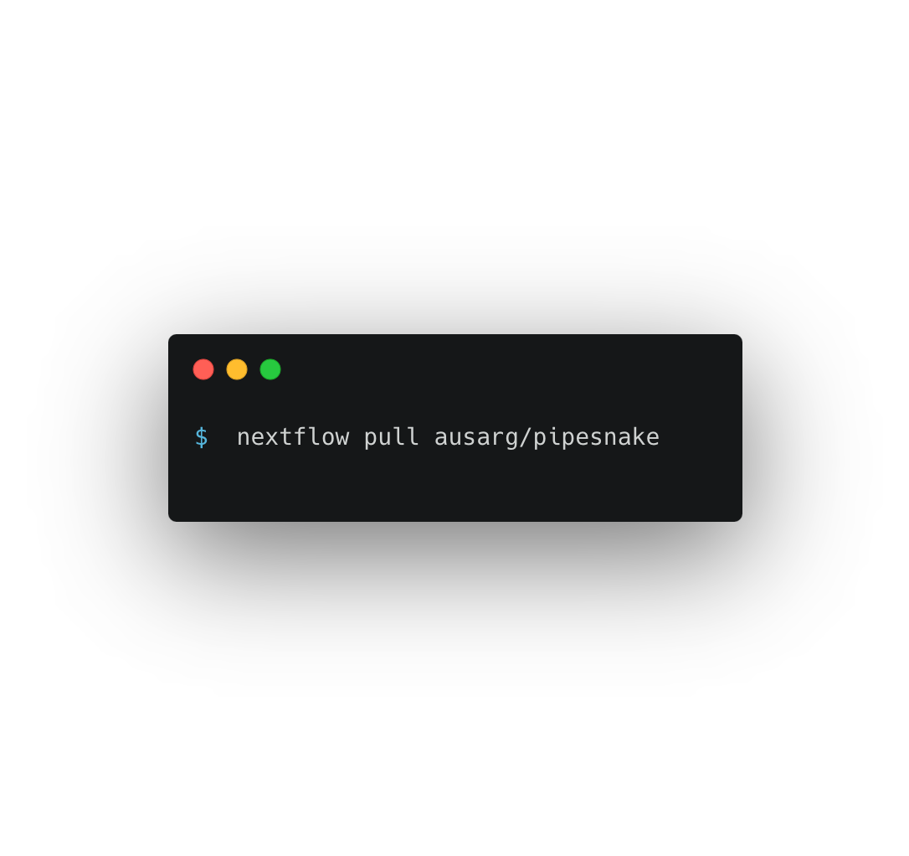
simple installation

Slide 21
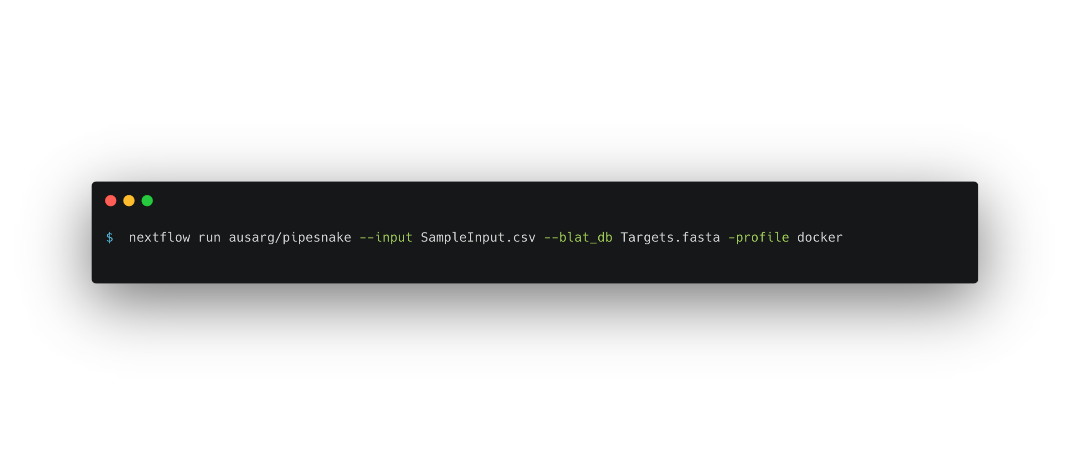
single-line command

Slide 22
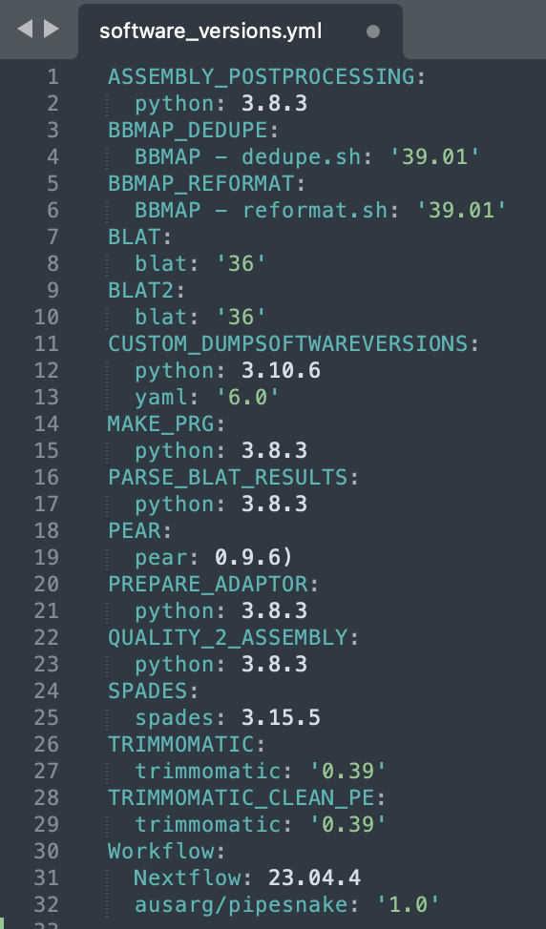
reproducible by default

Slide 23
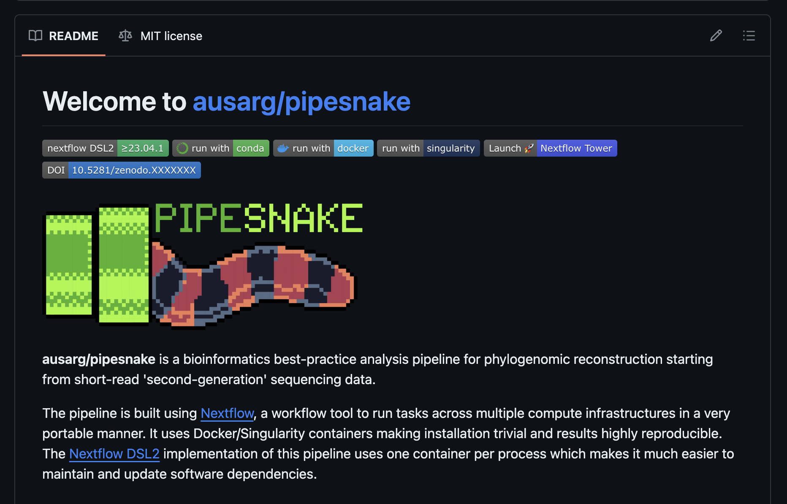
github.com/AusARG/pipesnake
github.com/AusARG/pipesnake

Slide 24
Phenomics
❷
Notes:
The molecular focus of the AusARG initiative has always been balanced by an interest in collecting a matching morphological dataset that can be used to understand the evolution of Australia’s reptiles.

Slide 25
Phenomics
❷
21 MEASUREMENTS FROM 6500+ SPECIMENS
Notes:
To this end, we’ve been collecting a standard set of morphological measurements from thousands of lizards, snakes, and frogs.

Slide 26
Phenomics
❷
21 MEASUREMENTS FROM 6500+ SPECIMENS
970+ SPECIES
Notes:
This dataset is now enormous and constitutes likely the largest such effort for reptiles to date. However, it still lags behind similar efforts for birds, which recently released a global dataset covering nearly all described species.

Slide 27
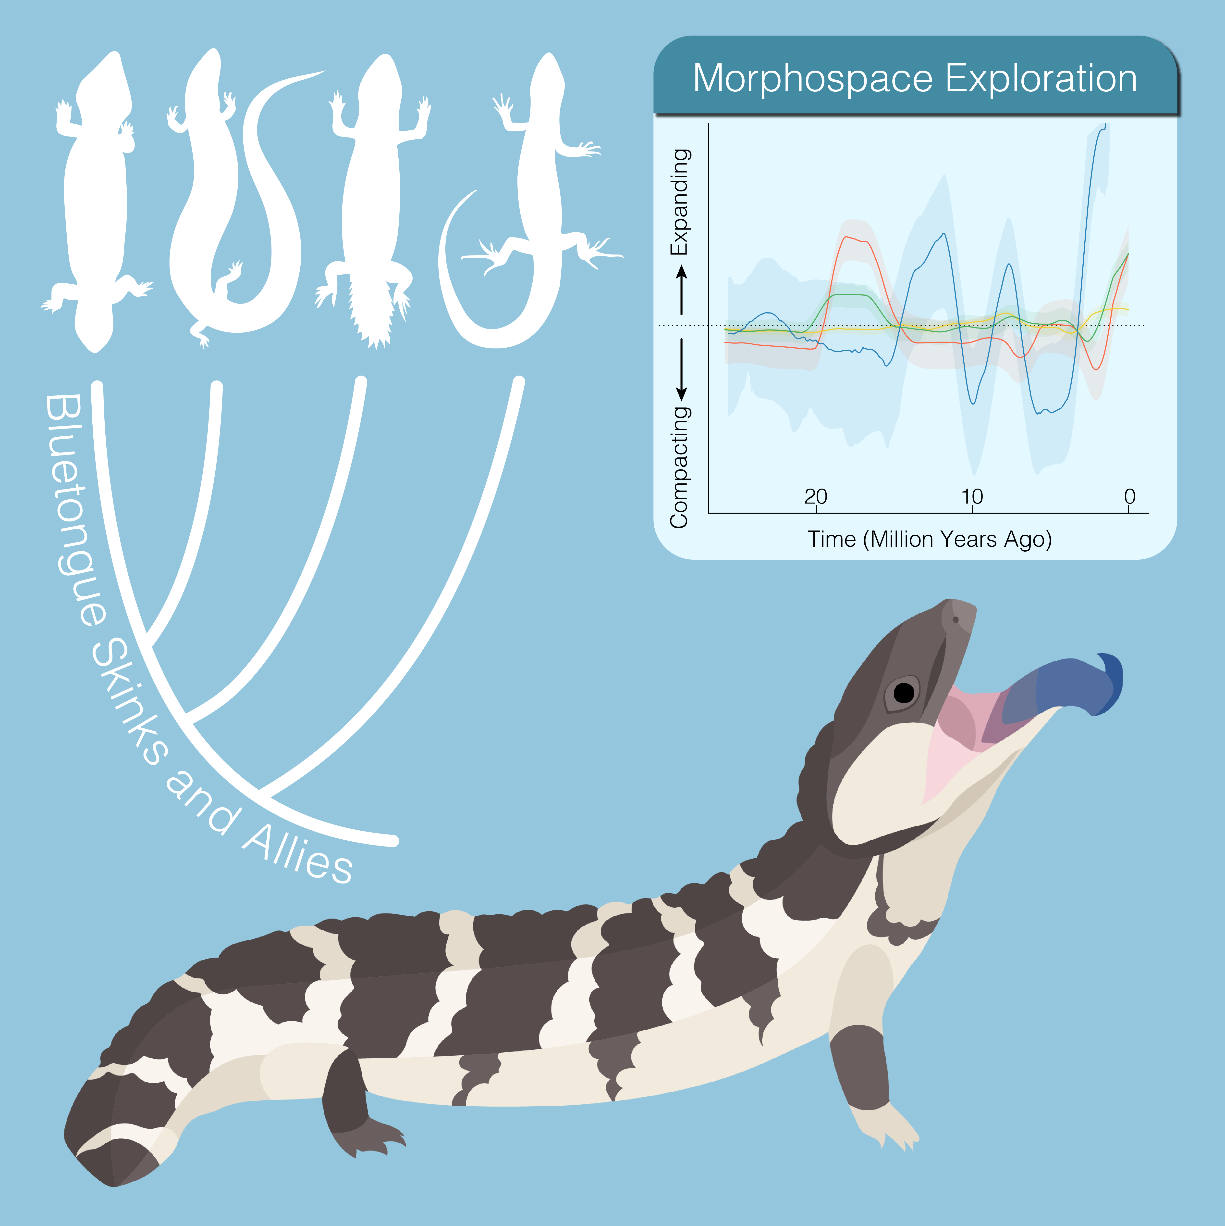
combined-evidence phylogeny

Slide 28
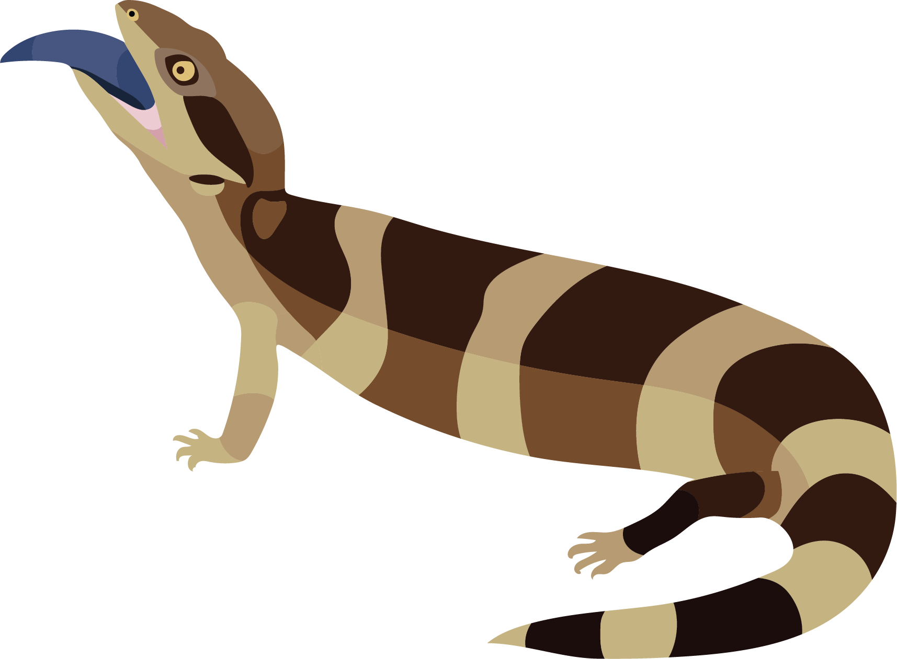
BRENNAN ET AL. (2024). ORIGINS OF NOVEL MORPHOLOGIES IN TILIQUINI SKINKS CURRENT BIOLOGY
Notes:
Together, these molecular and morphological data have been an incredible resource for study, and we’ve successfully published a number of papers over the past few years. I highlight a few here that I think are particularly relevant.

Slide 29
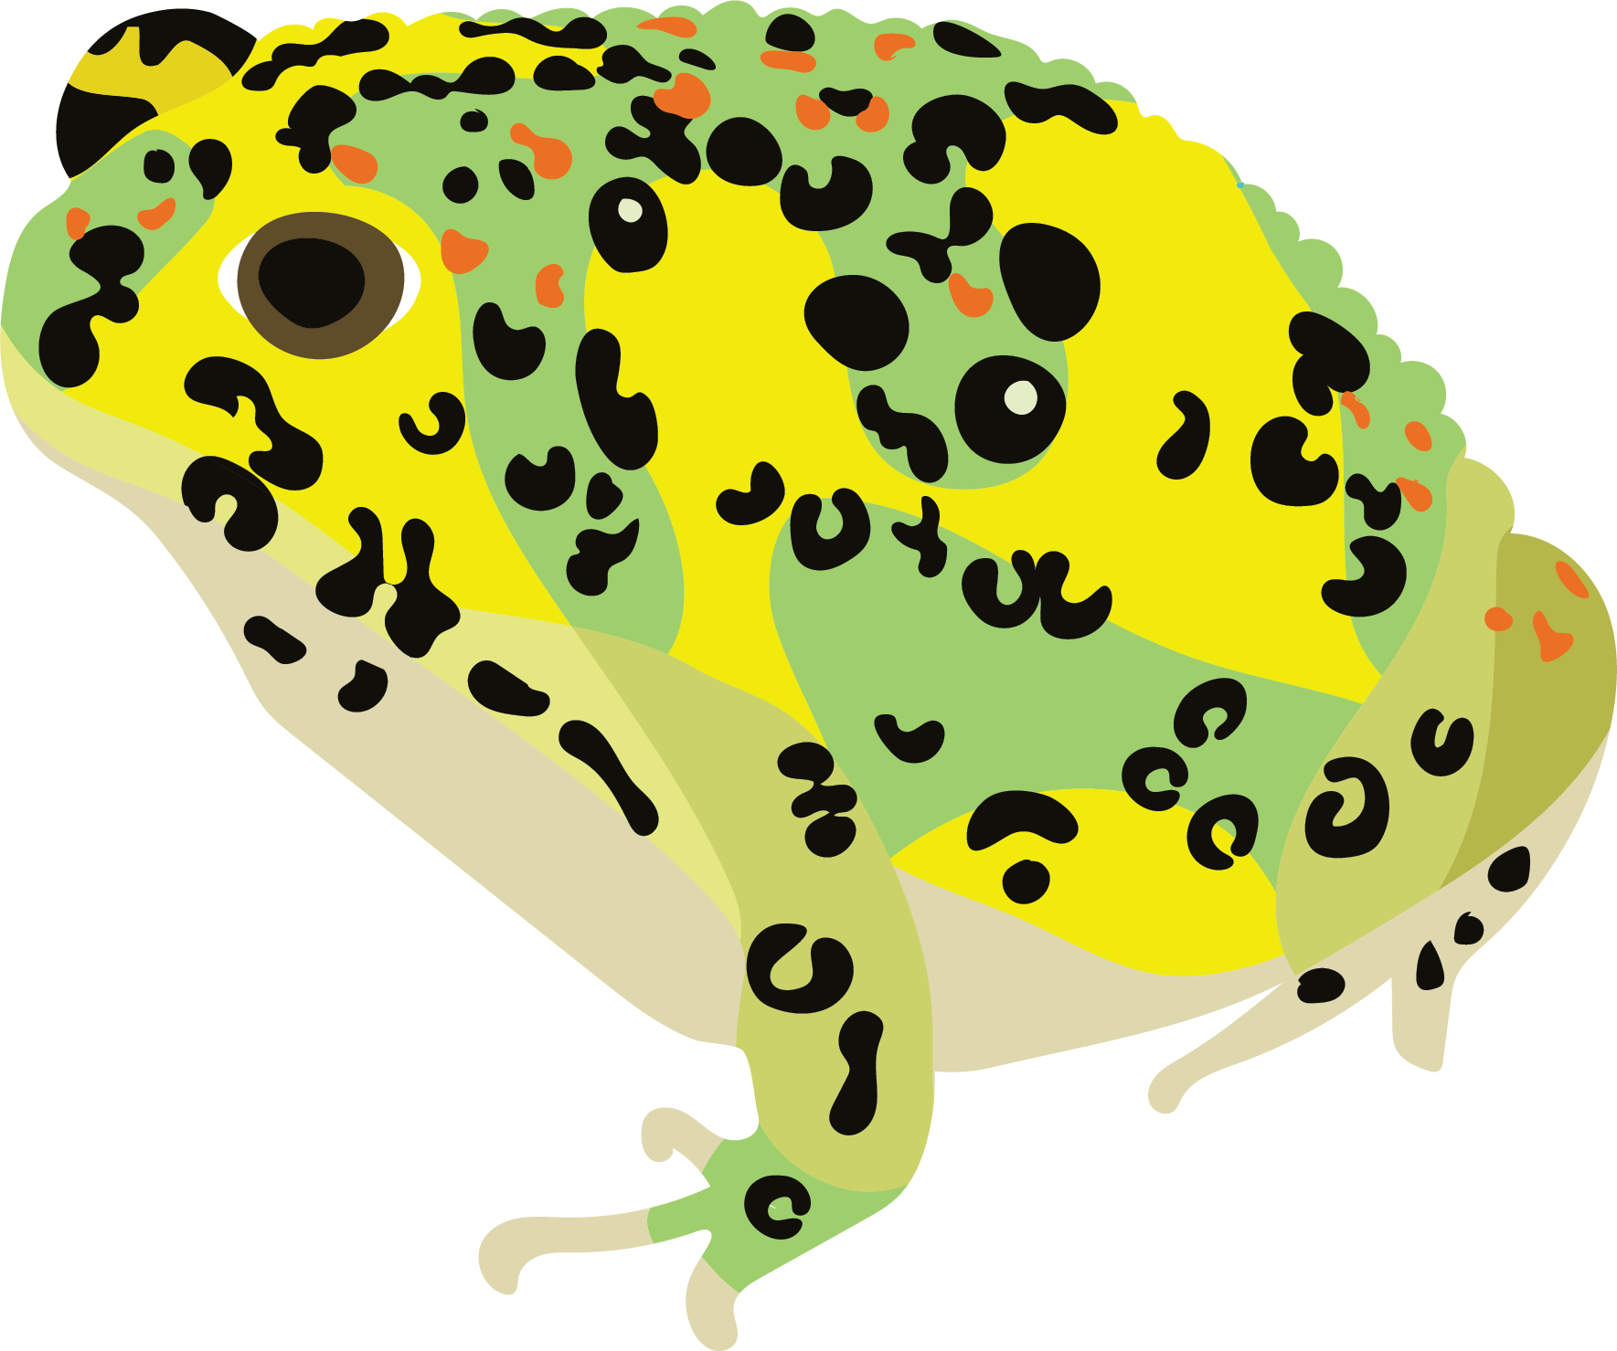
BRENNAN ET AL. (2024). ORIGINS OF NOVEL MORPHOLOGIES IN TILIQUINI SKINKS CURRENT BIOLOGY
BRENNAN ET AL. (2023). STAGGERED DIVERSIFICATION OF AUSTRALIAN FROGS
SYSTEMATIC BIOLOGY

Slide 30
BRENNAN ET AL. (2024). ORIGINS OF NOVEL MORPHOLOGIES IN TILIQUINI SKINKS CURRENT BIOLOGY
BRENNAN ET AL. (2023). STAGGERED DIVERSIFICATION OF AUSTRALIAN FROGS
SYSTEMATIC BIOLOGY
TIATRAGUL ET AL. (2023). THE RAPID RADIATION OF AUSTRALIAN BLINDSNAKES
MOLECULAR PHYLOGENETICS & EVOLUTION

Slide 31
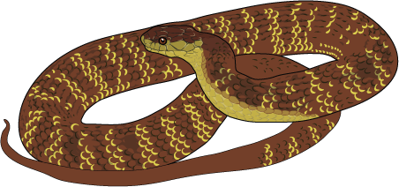
BRENNAN ET AL. (2024). ORIGINS OF NOVEL MORPHOLOGIES IN TILIQUINI SKINKS CURRENT BIOLOGY
BRENNAN ET AL. (2023). STAGGERED DIVERSIFICATION OF AUSTRALIAN FROGS
SYSTEMATIC BIOLOGY
TIATRAGUL ET AL. (2023). THE RAPID RADIATION OF AUSTRALIAN BLINDSNAKES
MOLECULAR PHYLOGENETICS & EVOLUTION
ESQUERRÉ ET AL. (2020/2022). ECOMORPHOLOGICAL DIVERSIFICATION OF PYTHONS
SYSTEMATIC BIOLOGY / BIOLOGY LETTERS

Slide 32
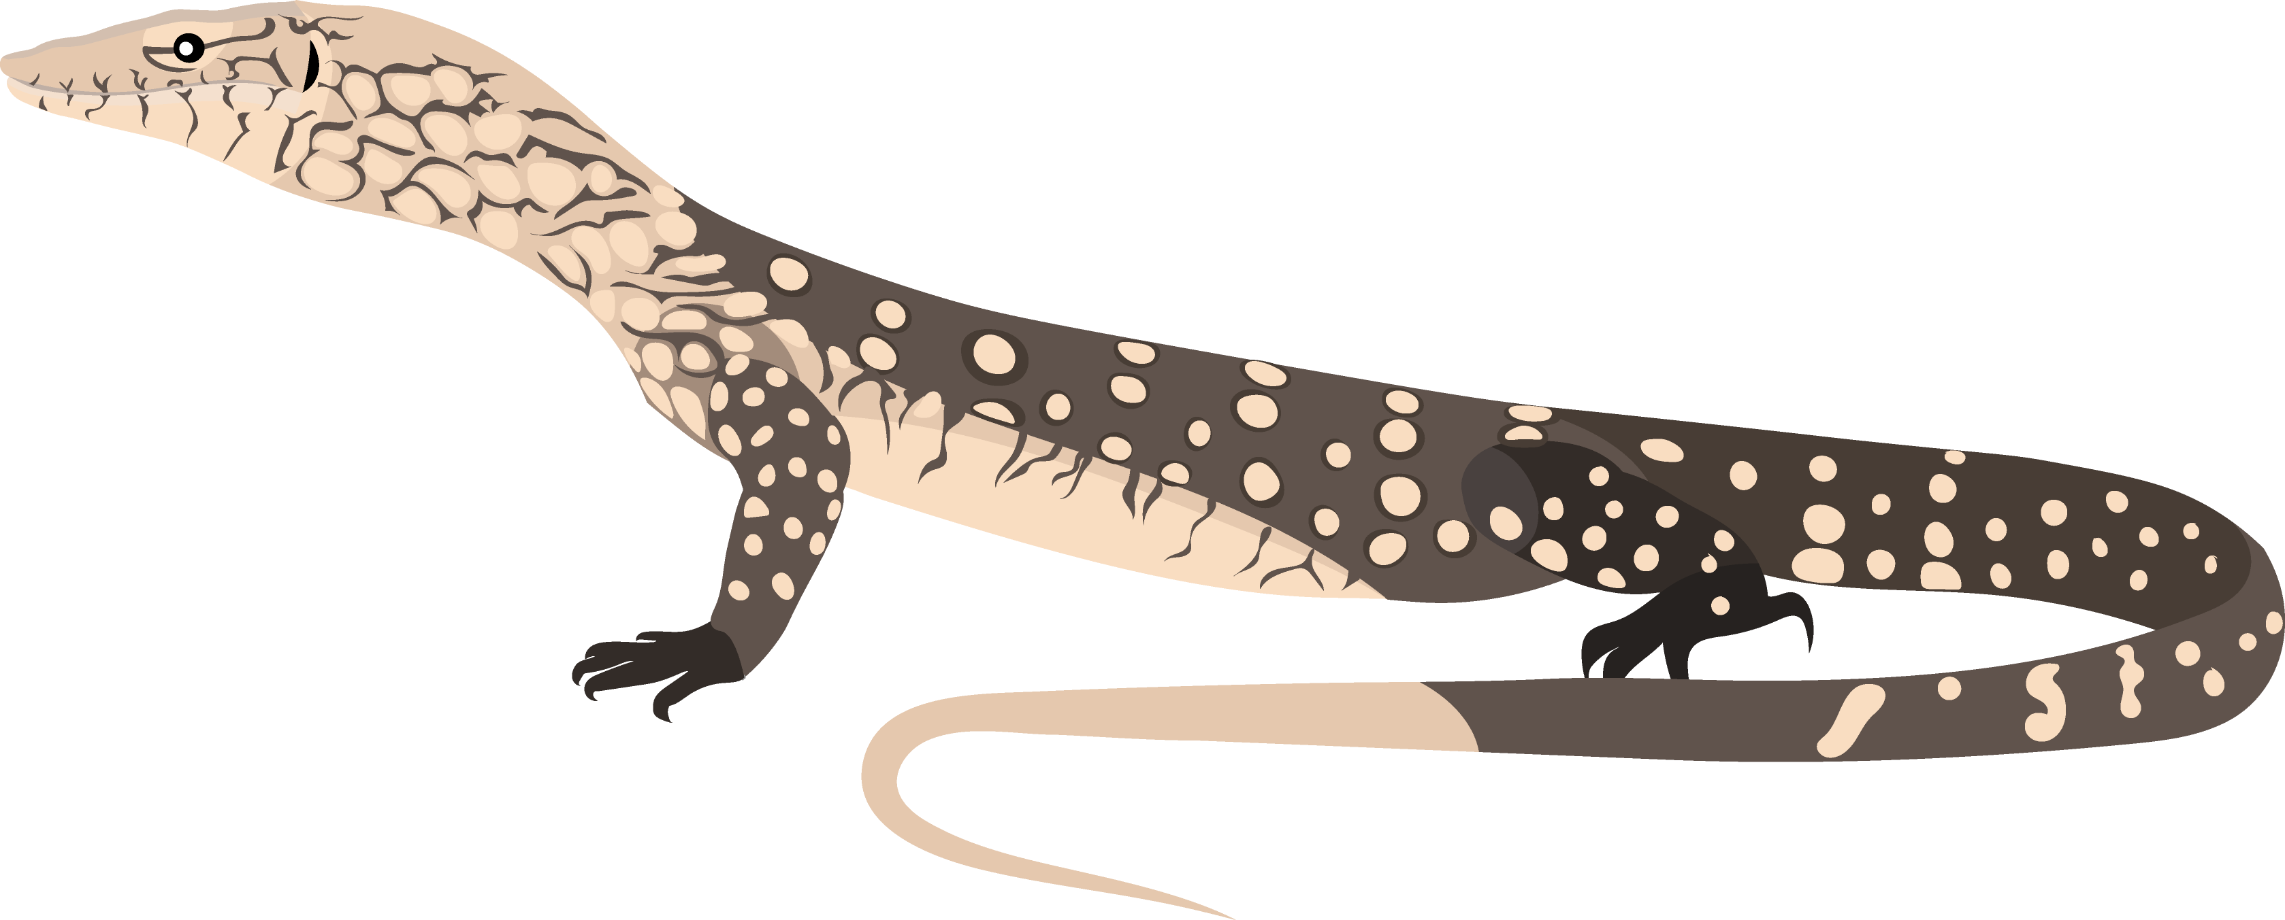
BRENNAN ET AL. (2024). ORIGINS OF NOVEL MORPHOLOGIES IN TILIQUINI SKINKS CURRENT BIOLOGY
BRENNAN ET AL. (2023). STAGGERED DIVERSIFICATION OF AUSTRALIAN FROGS
SYSTEMATIC BIOLOGY
TIATRAGUL ET AL. (2023). THE RAPID RADIATION OF AUSTRALIAN BLINDSNAKES
MOLECULAR PHYLOGENETICS & EVOLUTION
ESQUERRÉ ET AL. (2020/2022). ECOMORPHOLOGICAL DIVERSIFICATION OF PYTHONS
SYSTEMATIC BIOLOGY / BIOLOGY LETTERS
PAVÓN-VÁZQUEZ ET AL. (2021/2021). INCUMBENCY AND INTROGRESSION IN MONITOR LIZARDS
SYSTEMATIC BIOLOGY /
EVOLUTION

Slide 33
BRENNAN ET AL. (2024). ORIGINS OF NOVEL MORPHOLOGIES IN TILIQUINI SKINKS CURRENT BIOLOGY
BRENNAN ET AL. (2023). STAGGERED DIVERSIFICATION OF AUSTRALIAN FROGS
SYSTEMATIC BIOLOGY
TIATRAGUL ET AL. (2023). THE RAPID RADIATION OF AUSTRALIAN BLINDSNAKES
MOLECULAR PHYLOGENETICS & EVOLUTION
ESQUERRÉ ET AL. (2020/2022). ECOMORPHOLOGICAL DIVERSIFICATION OF PYTHONS
SYSTEMATIC BIOLOGY / BIOLOGY LETTERS
PAVÓN-VÁZQUEZ ET AL. (2021/2021). INCUMBENCY AND INTROGRESSION IN MONITOR LIZARDS
SYSTEMATIC BIOLOGY /
EVOLUTION
BRENNAN ET AL. (2021). CHARACTER DISPLACEMENT IN MONITOR LIZARDS
SYSTEMATIC BIOLOGY

Slide 34
a perfect resource for student projects
Notes:
While we’ve published a number of projects using these data, we’ve really only scraped the surface. And there’s so much more that could be done, particularly with undergraduate and postgraduate students.
We’ve already done a lot of the hard work that can slow down or derail student projects (collecting samples, vetting them, gaining approval and access). But existing sampling can act as a platform for students to build upon.

Slide 35
processed molecular data
a perfect resource for student projects
Notes:
Can add sampling through low coverage WGS or reference genomics

Slide 36
processed molecular data
existing morphology data
a perfect resource for student projects
Notes:
Can expand intraspecific sampling for focused projects

Slide 37
processed molecular data
existing morphology data
friendly and diverse colleagues
a perfect resource for student projects
Notes:
Collaborators and colleagues from population genomics to comparative methods, domestic and international, and high quality good people. We also have the computer literacy and computational skills that might interest students not directly interested in the organismal part of biology!

Slide 38
Future Directions:
comparative look across all Australian reptiles
expand morphological sampling of global reptiles
push forward our understanding of tempo/mode in the largest terrestrial vertebrate clade

Slide 39
Funding:
Australian Research Council (DP Scheme)
UK Research Institute
Collaborators:
AusARG Phylogenomics Team (ANU, U.Wollongong, Griffith U., U.Michigan)
Natalie Cooper (NHM, UK)
Gavin Thomas (Sheffield Uni, UK)
Thomas Guillerme (Sheffield Uni, UK)
Notes:
Scott Keogh (ANU), Craig Moritz (ANU), Natalie Cooper (NHM), Damien Esquerre (Wollongong)

Slide 40
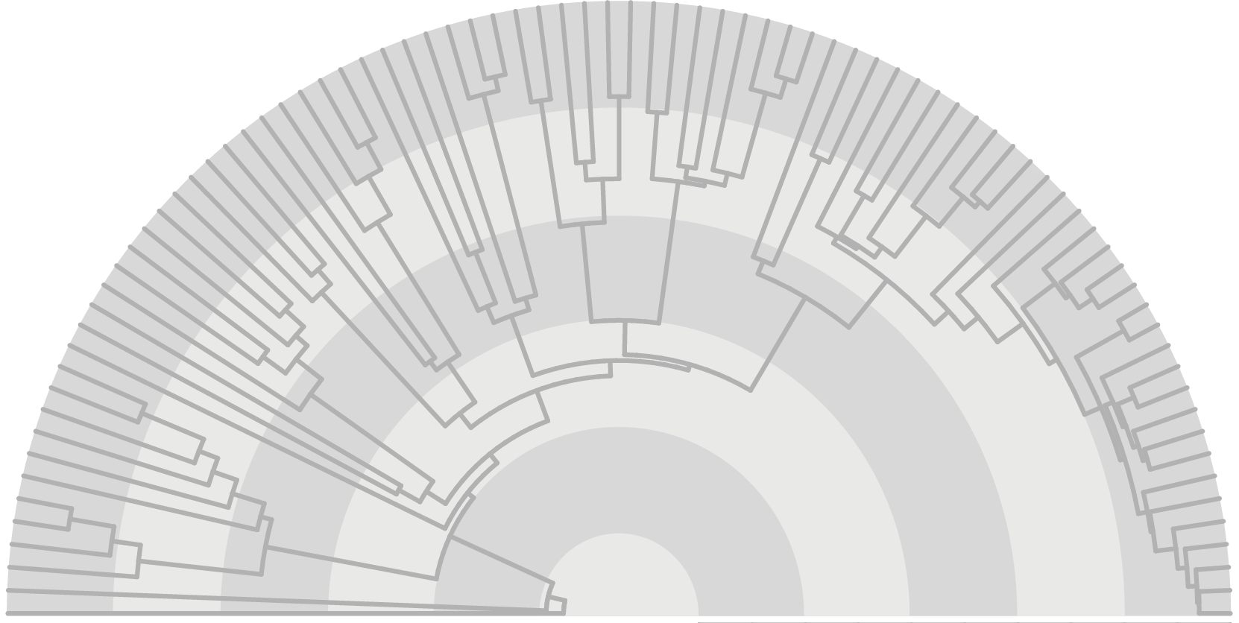
Assembling the Squamate Tree-of-Life

Slide 41
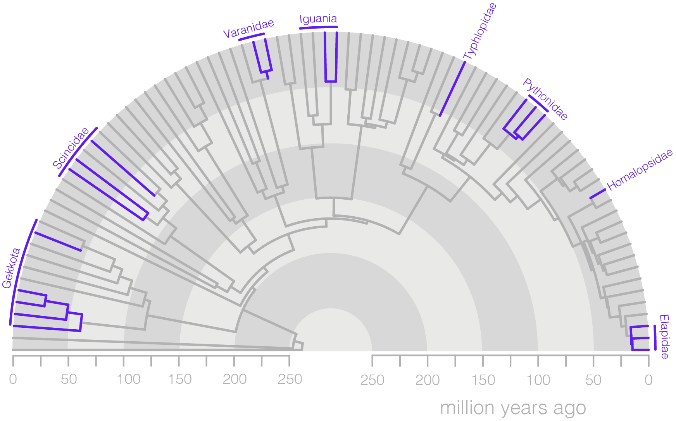
Includes Oz clade

Slide 42
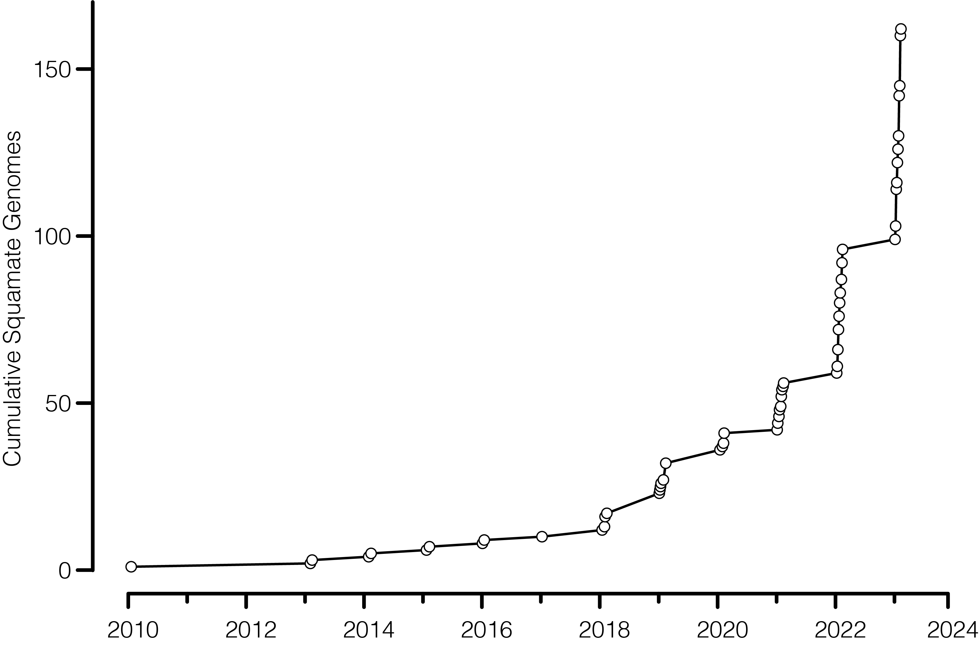
building genomic resources
280+ genomes
140+ snakes
50+ iguanians
Notes:
~100 of these have been added in the last 12 months.

Slide 43
available genomes
Mammals:
3,933
Fish:
2,595
Birds:
1,784
Squamates:
282

Slide 44

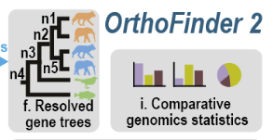
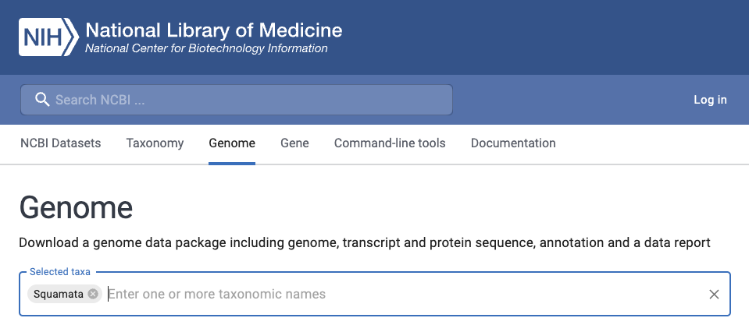

13,599
11,171
collecting data
6,791
Single Copy Orthologs (SCO)
96 Species

Slide 45
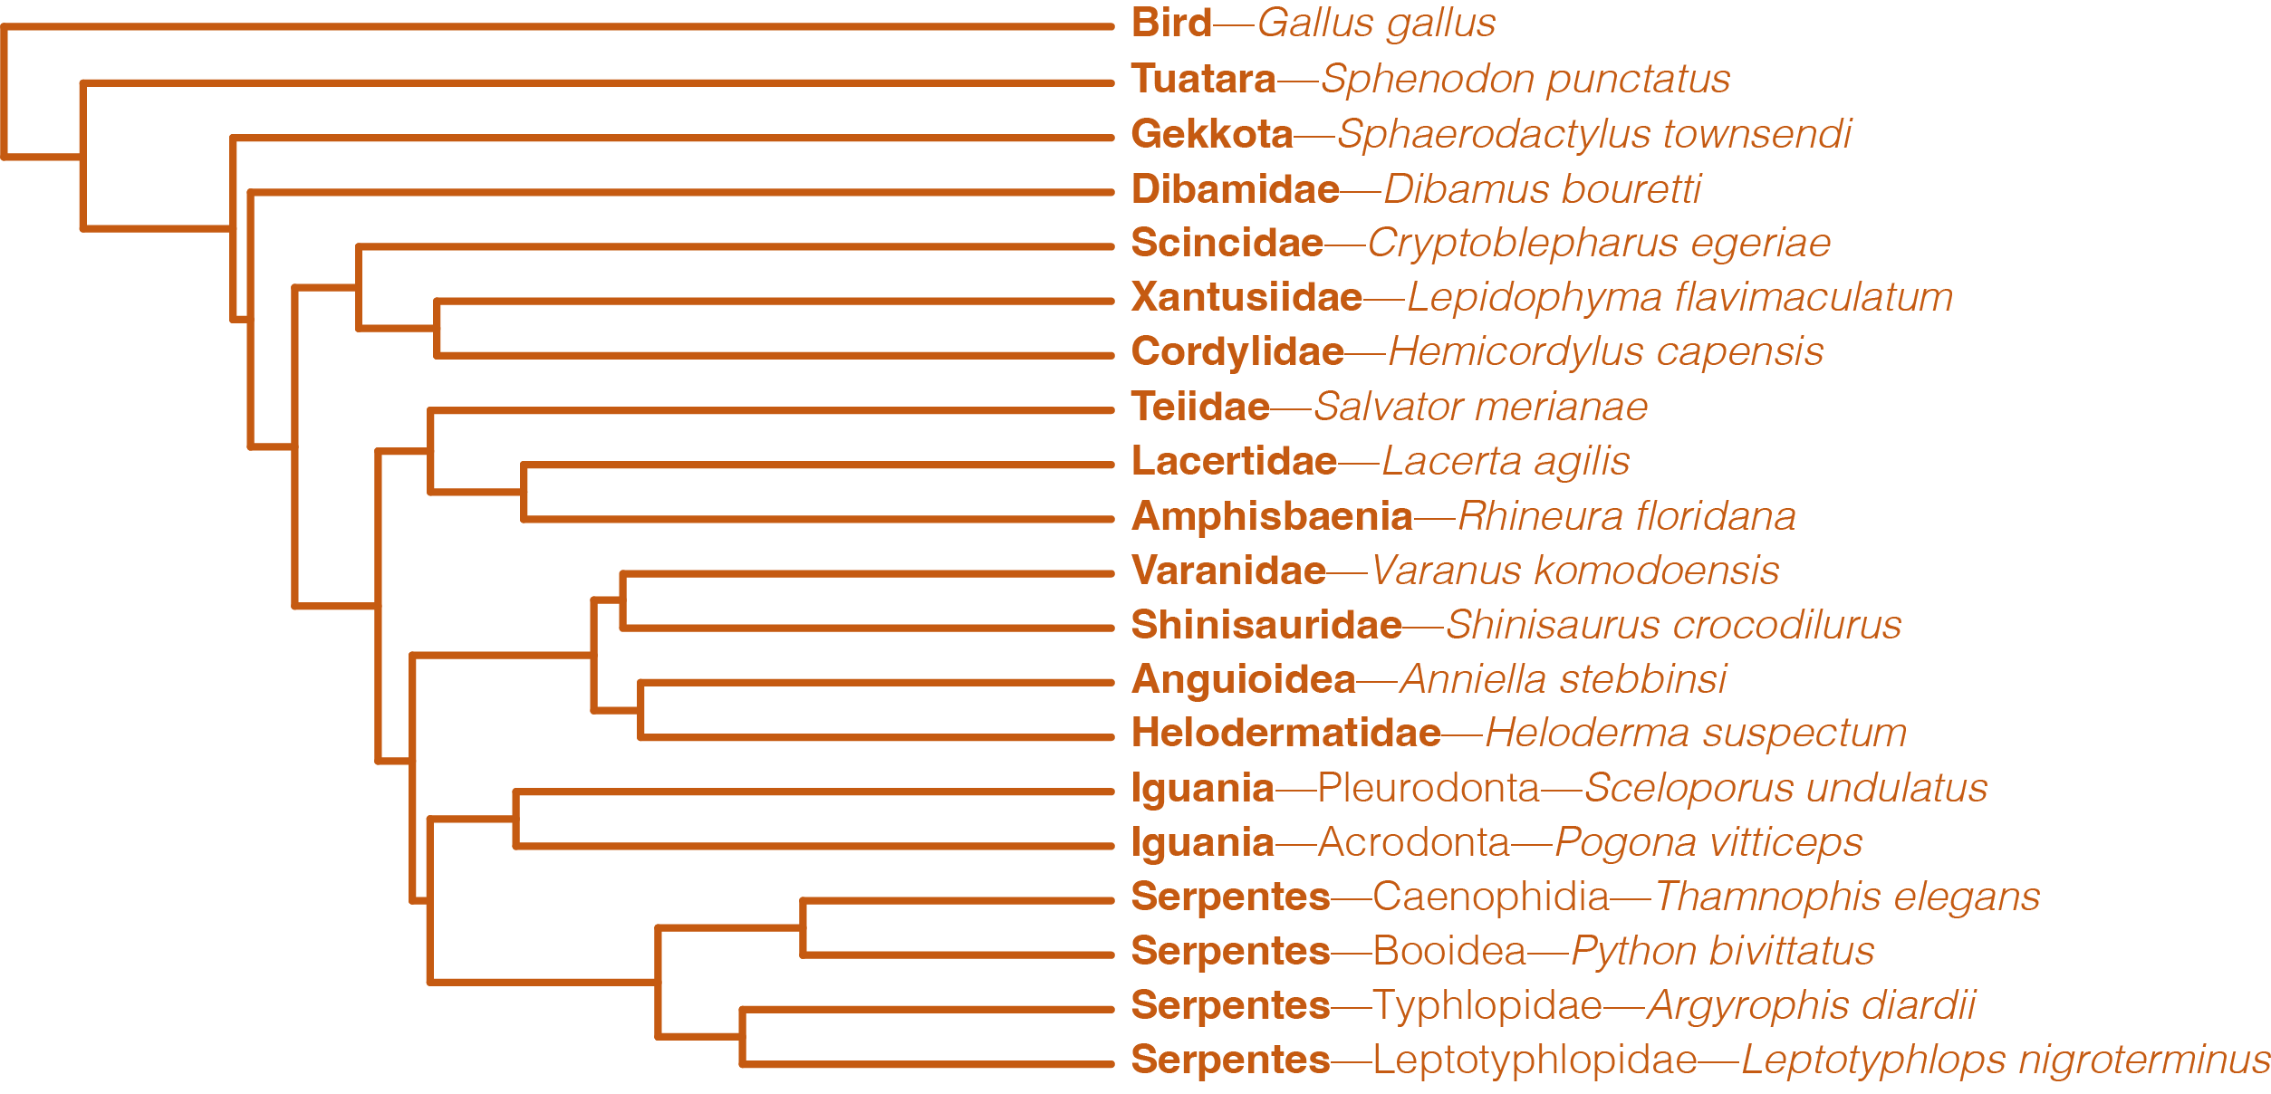

Slide 46
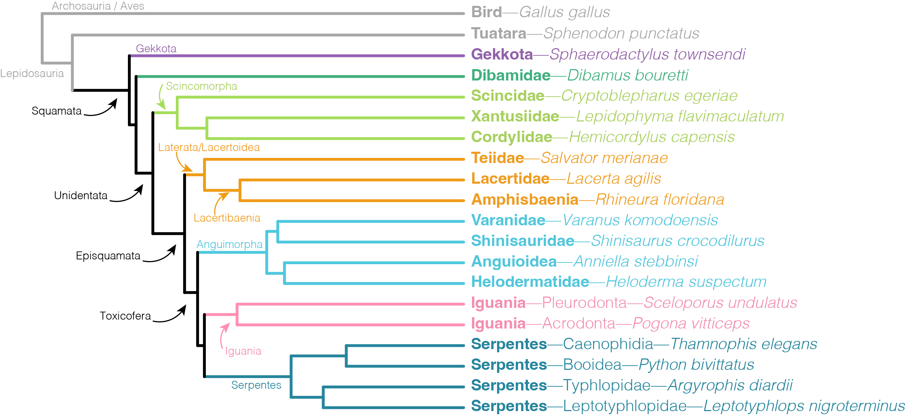

Slide 47
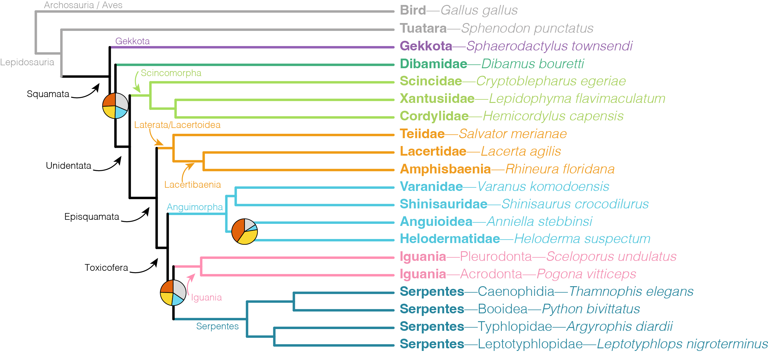
Notes:
Piecharts at nodes represent the proportion of gene trees that support the most common species tree topologies (orange is the topology presented), yellow and blue are swaps with the nearest neighbor branches and grey is a summary of many other alternatives. We’ll just focus on the orange, which shows for these nodes, there are a majority of gene trees that support some other topology rather than that shown, suggesting there’s lots more to learn about the phylogenetics of some deep splits in squamates.

Slide 48
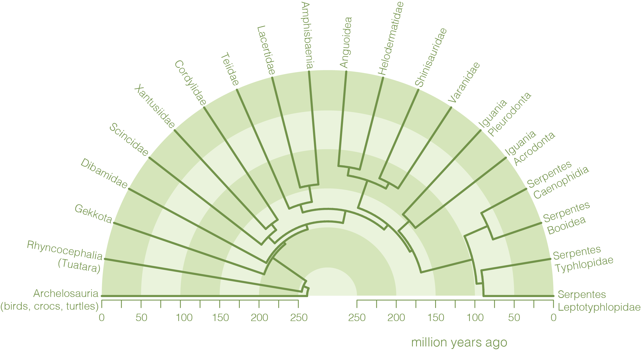
Notes:
We used a number of fossils (more than a dozen) to time calibrate the our new phylogeny

Slide 49
T/J Extinction
201

Slide 50
Squamate Crown
200

Slide 51
Crown Snakes
100

Slide 52
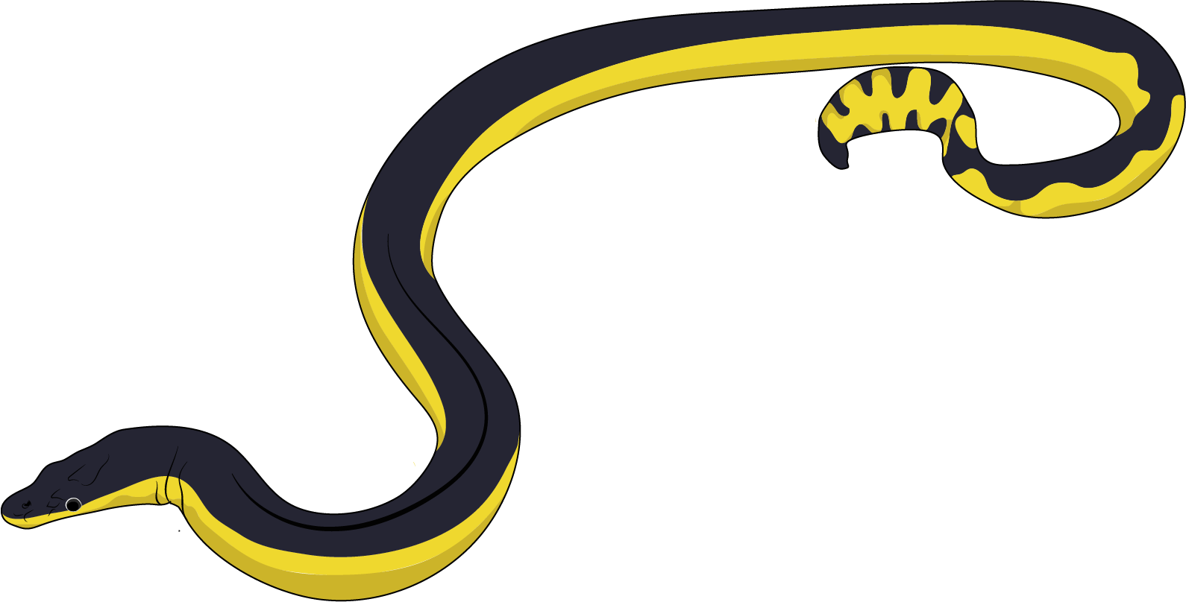
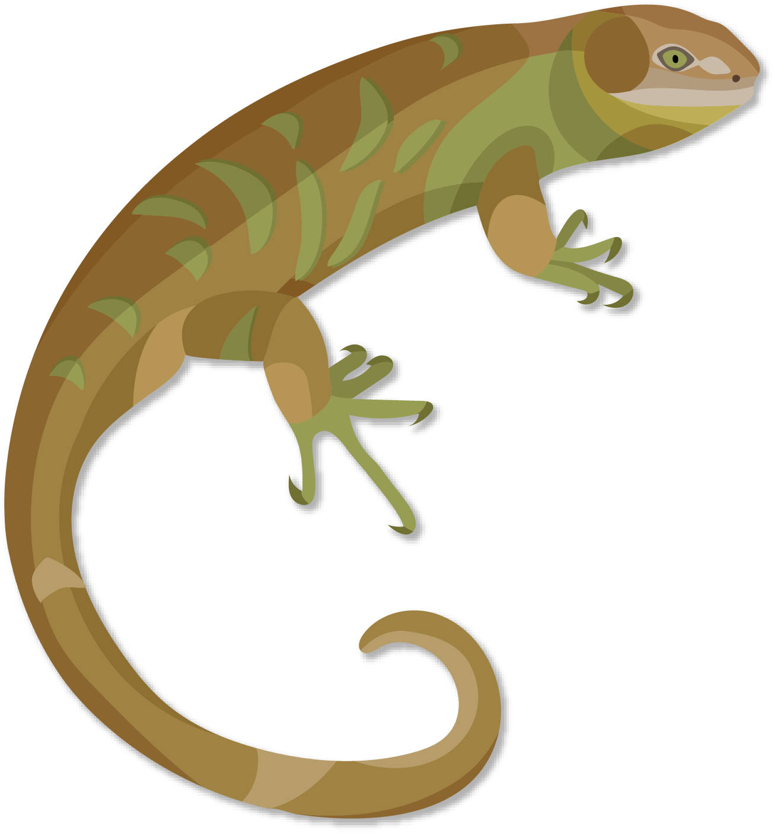
Future Directions:
expand sampling of Australian reptiles
work towards resolving squamate tree-of-life
investigate patterns of molecular evolution
interrogate signal at unresolved nodes
Notes:
considering we have 10% of the global diversity, we should definitely have better representation!
leaves open room for many follow up questions which might be interesting to investigate with other researchers at SOLES. E.g. patterns of molecular evolution, convergence, etc.

Slide 53
Funding:
USA National Science Foundation
Iridian Genomics
Rockefeller Foundation
Existing funding!
Collaborators:
Open Consortium on Squamate Genomics (global)
Many domestic and international colleagues

Slide 54
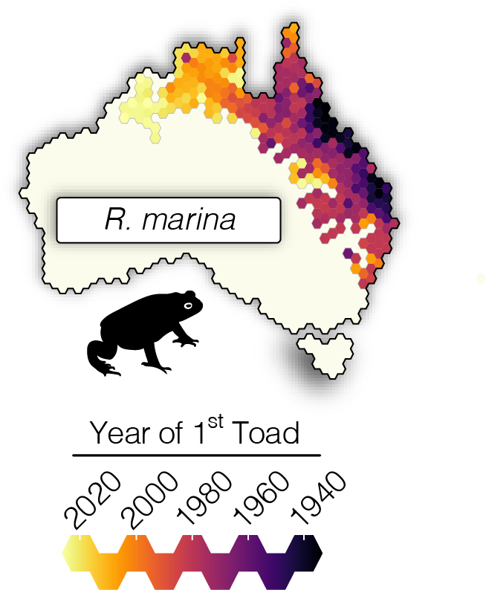
Genomics for
Conservation
Notes:
The last area is a bit of a pivot, but one that I think is exciting, with high applicability, and funding potential.

Slide 55
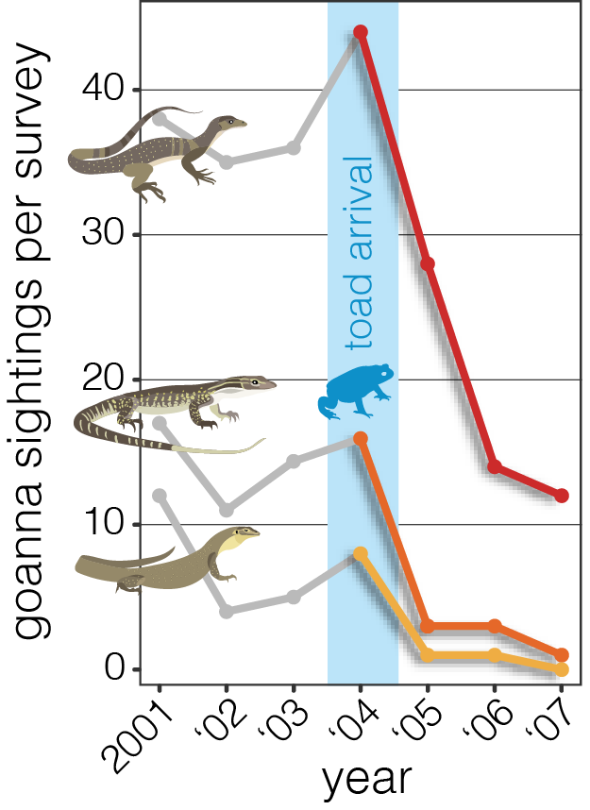
toads have been devastating

Slide 56
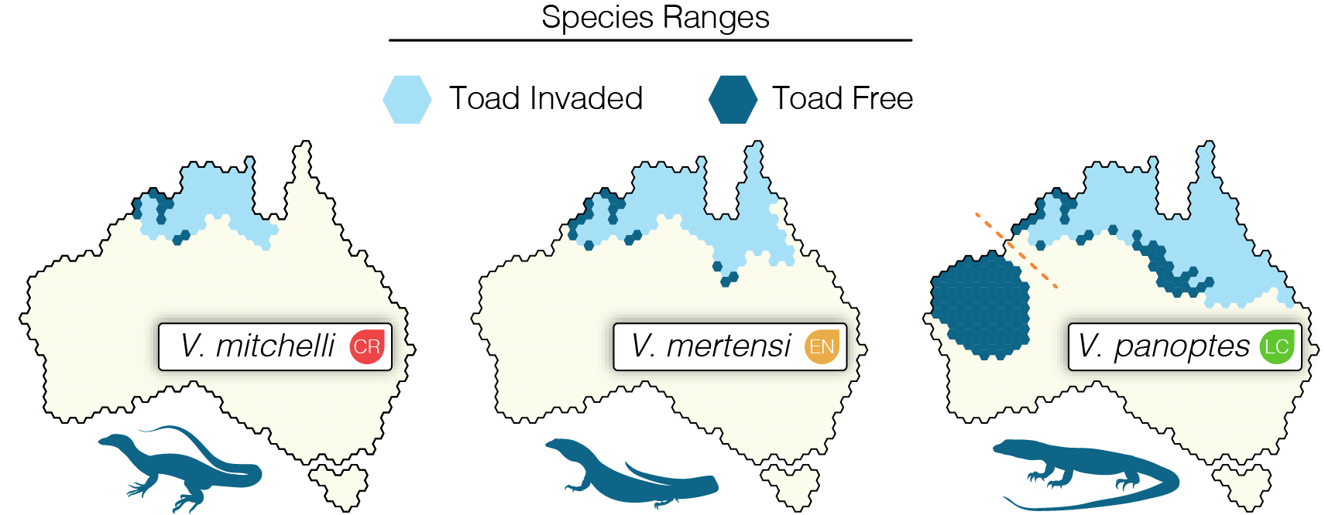
Notes:
a replicated approach to study the genomic impacts of cane toad induced population crashes

Slide 57
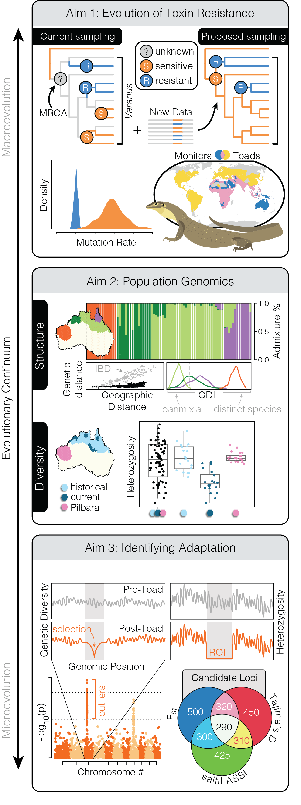
monitors and toads don’t clash everywhere
Notes:
Across large parts of Africa and asia, goannas and toads coexist and monitors prey on toads with no ill effects

Slide 58
resolve the history of toxin sensitivity
Notes:
to understand if Australian monitors have always been susceptible to toad toxin, or if they've secondarily lost it. This is important because existing conservation suggestions recommend allowing evolution to develop resistant populations. Is this even plausible?

Slide 59
assess population genomics

Slide 60
assess historical diversity

Slide 61
investigate genetic health
identify signs of selection

Slide 62
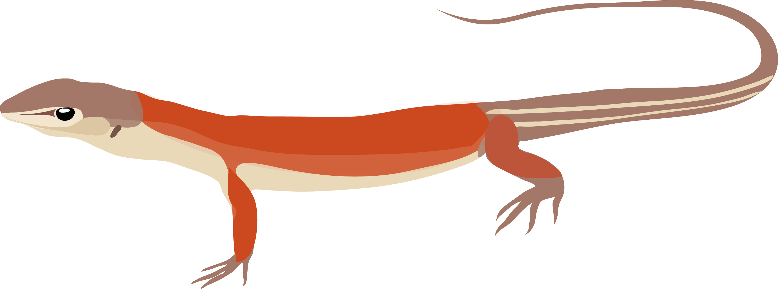
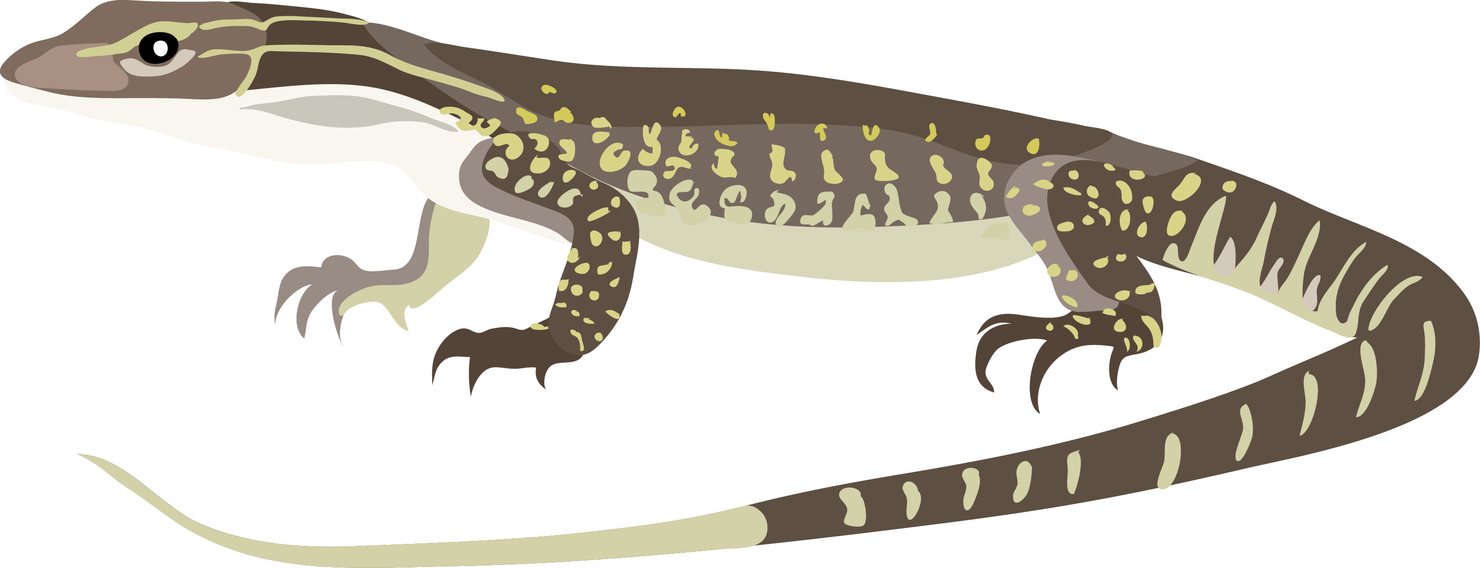
Future Directions:
investigate suitability of gene-editing for goanna conservation
develop land owner & manager investment through ecology
expand genetic monitoring (particularly V. mitchelli )

Slide 63
Funding:
Hermon Slade
Australian Research Council (DECRA Scheme)
Where else
Collaborators:
Threatened Species Initiative
Australian Wildlife Conservancy
Larrakia Rangers (NT)
NT/WA Museums

Slide 64


COLLABORATORS
SUPPORTED BY
+ SCOTT KEOGH
+ STEVE DONNELLAN
+ POLINA NOVIKOVA
+ PUTTER TIATRAGUL
+ CARLOS PAVON VAZQUEZ
+ NICCY AITKEN
+ ZIAD AL BKHETAN
+ SONAL SINGHAL
+ . . . MANY MORE
AUSTRALIAN
NATIONAL
UNIVERSITY

Slide 65

Goals at SOLES
Dynamic and collaborative research program
Contribute to an exciting research department
Support and encourage the next generation of scientists
Passionate researcher
Motivated supervisor
Keen teacher

Slide 66
github.com/iangbrennan/USydney

